Slide 1
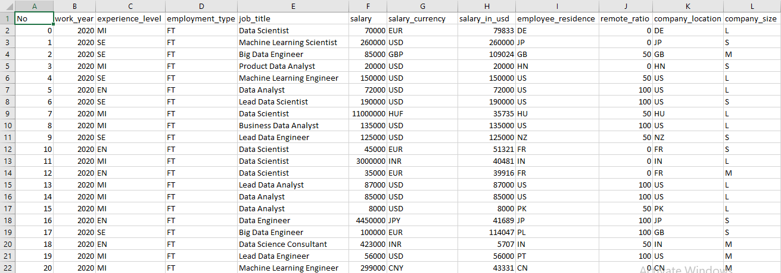
Data Science Job Salaries
Preview of the dataset
Column | Description
work_year | The year the salary was paid.
experience_level | The experience level in the job during the year with the following possible values: EN Entry-level / Junior MI Mid-level / Intermediate SE Senior-level / Expert EX Executive-level / Director
employment_type | The type of employement for the role: PT Part-time FT Full-time CT Contract FL Freelance
job_title | The role worked in during the year.
salary | The total gross salary amount paid.
salary_currency | The currency of the salary paid as an ISO 4217 currency code.
salary_in_usd | The salary in USD (FX rate divided by avg. USD rate for the respective year via fxdata.foorilla.com).
employee_residence | Employee's primary country of residence in during the work year as an ISO 3166 country code.
remote_ratio | The overall amount of work done remotely, possible values are as follows: 0 No remote work (less than 20%) 50 Partially remote 100 Fully remote (more than 80%)
company_location | The country of the employer's main office or contracting branch as an ISO 3166 country code.
company_size | The average number of people that worked for the company during the year: S less than 50 employees (small) M 50 to 250 employees (medium) L more than 250 employees (large)

Slide 2
Problem Statement & Aim
Problem Statement : To identify factors influencing data science salaries and predict salary ranges based on various features such as work year, experience level, employment type, remote ratio, company size, and location.
Aim: aim to achieve a comprehensive understanding of the factors that impact data science salaries. This includes exploring the relationship between different features and salary levels, identifying trends in salary distribution, and providing insights to decision makers in the data science domain.

Slide 3
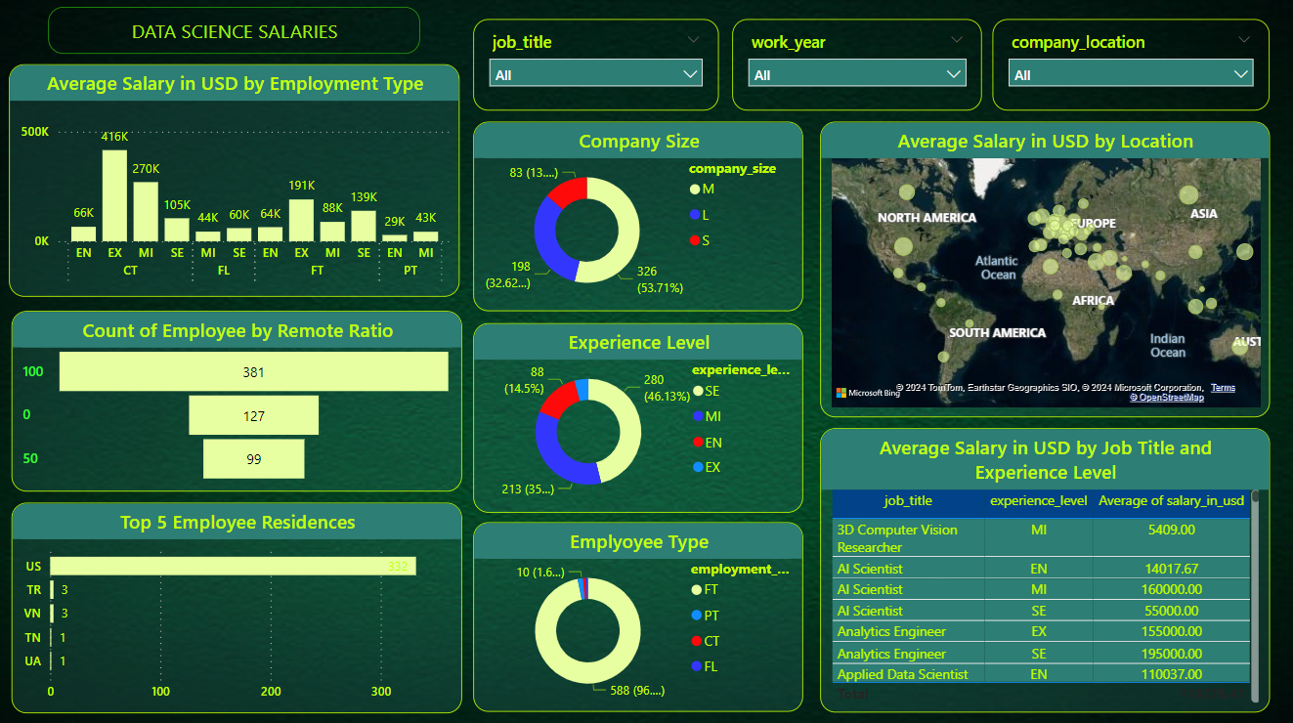
Data Science Job Salaries Dashboard

